Slide 1
PROJECT PRENSENTATION
MOVIE SALES DASHBOARD
Presented By: K. Vamshi
Batch No:436

Slide 2
About me
Name: Kandela Vamshi
Qualification :
Bachelors In Data Science (2025)-(7.7 CGPA)
I Strongly Believe That Quality Teaching is Done by When We have Less Quantity . Innomatics is taking limit in strength .
AS A Passionate on Making “Data into Meaningful insight”
LinkedIn :
www.linkedin.com/in/kandela-vamshi-2b4457258
GitHub :
https://github.com/Vamshikandela/Vamshikandela

Slide 3
AGENDA
BUSINESS PROBLEM
BUSINESS OBJECTIVE
DATASET OVERVIEW
DATA CLEANING
DAX MEASURES
CHALLENGES FACED
DASH BOARD HIGHLIGHTS
KEYS & INSIGHTS
CONCLUSION

Slide 4
BUSINESS PROBLEM
The production company is facing recurring financial losses due to poor budgeting decisions, inaccurate prediction of movie performance, incorrect genre prioritization, and lack of data-driven planning.
To analyze the movie dataset to understand why the producer is facing financial losses across multiple film projects.
To examine key factors such as production budget, revenue, ratings, votes, runtime, genres, and release year to identify performance gaps.
To compare investment vs. return trends and detect patterns causing underperforming movies.
To generate clean, structured data suitable for Power BI dashboards that highlight risk areas and financial leak points.
To derive insights that explain what drives a movie’s success or failure, helping the producer make data-driven investment decisions.
To present findings in a clear, visually actionable format that supports strategic planning for future movie productions.

Slide 5
BUSINESS OBJECTIVE
To Analyse the IMDB movie dataset consisting of 1,000 movies across 12 key attributes.
To Prepare clean, structured data suitable for Power BI dashboard creation.
To Understand patterns in movie performance based on ratings, revenue, votes, runtime, genres, and release year.
To Identify meaningful trends and insights that help explain what drives a movie’s popularity and financial success.
To Present findings in a clear, visually appealing, and actionable format.

Slide 6
DATASET OVERVIEW
Dataset Contain:
Total Rows :1000
Total Columns :12
Type of Data : Mixed (Numerical + Categorical + Date)
        Data Description :
          Rank : The position of the movie in the ranking list.
          Title : The name of the movie.
          Genre : The primary genre(s) of the movie (e.g., Action, Drama).
          Description : Brief summary or synopsis of the movie plot.
          Director : The name of the movie’s director.
          Actors : Names of the main actors featured in the movie.
          Year : The year the movie was released.
          Runtime : Duration of the movie in minutes.
          Rating : The average viewer rating (e.g., IMDb rating).
          Votes : Total number of user votes received for the movie.
          Revenue (Millions) : Total revenue generated by the movie in millions of USD.
          Meta score : The Metacritic score representing critic reviews (0–100 scale).

Slide 7
DATA CLEANING & TRANSFORMATION
Handled Missing Values:
Revenue and Meta score had missing entries; treated through imputation or removal depending on context.
Standardized Data Types:
Converted numeric fields like Runtime, Revenue, Rating, and Votes to appropriate formats.
Processed Multi-Genre Column:
Split and normalized genres for accurate counting and visualization.
Removed Duplicates:
Ensured dataset integrity and consistency.
Text Fields Cleaned
Trimmed spaces, corrected formats, and ensured uniformity in Director and Actor names.

Slide 8
DAX MEASURES
Avg Rating
Avg Metascore
Avg Revenue (in millions)
Avg Runtime
Avg Votes
Box Office Collection
Genre Count
Highest Movie Revenue
Max_Revenue by Genre
Movie_Genre
Row Count
Total Genre
Total Movies
Total Revenue (in millions)
Total Votes
Unique Actors
Unique Directors

Slide 9
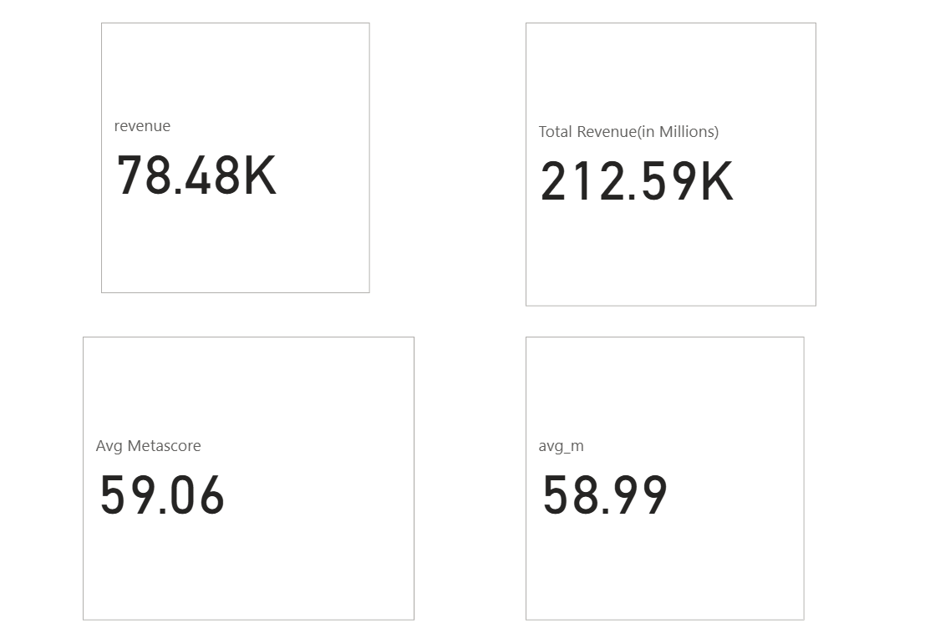
CHALLENGES FACED
Handling Missing Values: Mean vs Median Imputation
Mean Imputation
Replaces missing values with the average
Easy to apply
Total Revenue
Affected by outliers → result difference 134k(millions)
Meta Score
Affected by outliers → result difference (0.61)
Median Imputation
Replaces missing values with middle value
Robust to outliers

Slide 10

DASH BOARD HIGHLIGHTS

Slide 11
KEYS & INSIGHTS
Highest Revenue By Year:
In 2016, reached 709 highest number of movies releases and Total revenue generated 32.93k millions .
The total revenue generated overall from 2006 to 2016 78.48k millions
Highest Votes by Genre :
The Drama genre received the highest total number of votes, indicating it has the strongest audience engagement across all movie categories.
Drama movies accumulated approximately 74.78 million votes, making it the most interacted-with genre in the dataset.
Highest Revenue by Genre
The Adventure genre generated the highest total revenue, reaching approximately 39.19K million
Audience Engagement & Revenue Performance:
Franchise films like The Dark Knight, Inception, Avatar, and Star Wars attract both the highest audience engagement and the strongest box-office performance.
Overall, big-budget, high-visibility movies deliver the best combination of popularity and financial return.

Slide 12
Highest Revenue Directors & Actors
Top-grossing directors like J.J. Abrams and David Yates, along with leading actors such as Robert Downey Jr. and Jennifer Lawrence, drive the highest global revenues through major blockbuster franchises.

Slide 13
CONCLUSION
Top directors (e.g., J.J. Abrams(5,050 millions), David Yates(4,891 millions )) and leading actors (Robert Downey Jr.(2,564millions)), Jennifer Lawrence(1,655 millions)) drive the highest box-office returns.
Drama gains the most audience engagement, while Adventure delivers the strongest revenue performance.
Blockbuster franchises consistently outperform, proving the value of investing in proven Ips
.
Focusing on bankable talent and high-performing genres offers the most reliable path to profitability

Slide 14
THANK YOU

